Slide 1


NeedleBench: Can LLMs Do Retrieval and Reasoning in Information-Dense Context?
Lukas Czurgel

Slide 2

Overview
Table of Contents:
Motivation and Background
What is a context window?
Why we care about long context retrieval
Evaluating long context retrieval
Related Work
NIHA
RULER
LongBench
NeedleBench
Methodology
Evaluation
Results
Conclusion

Slide 3
Motivation & Background

Slide 4
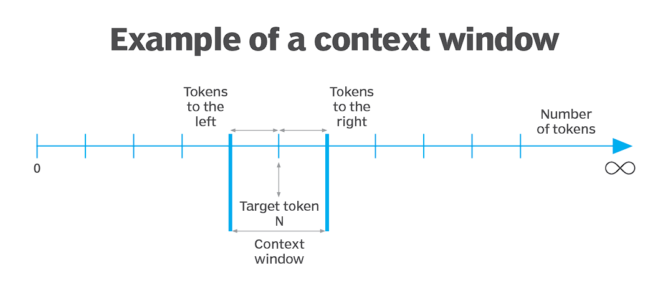
Background – What is a context window?
Working memory or RAM of models with transformer architecture
Contains the prompt, system prompt, conversation history and any additional documents relevant for the task at hand
We often use pre-selection techniques like RAG to maximize the relevant tokens in the context window
Notes:
- Working memory or RAM of models with transformer architecture, the most common among modern LLMs
Contains the prompt, system prompt conversations history and any additional documents to be considered in the task
Context size and parameter count are common hallmarks of modern LLMs
Googles Gemini 1.5 for instance prides itself on its 1 million token context window.
Context window is limited, so we employ techniques such as RAG to optimize the most relevant content for the limited tokens that can be included

Slide 5
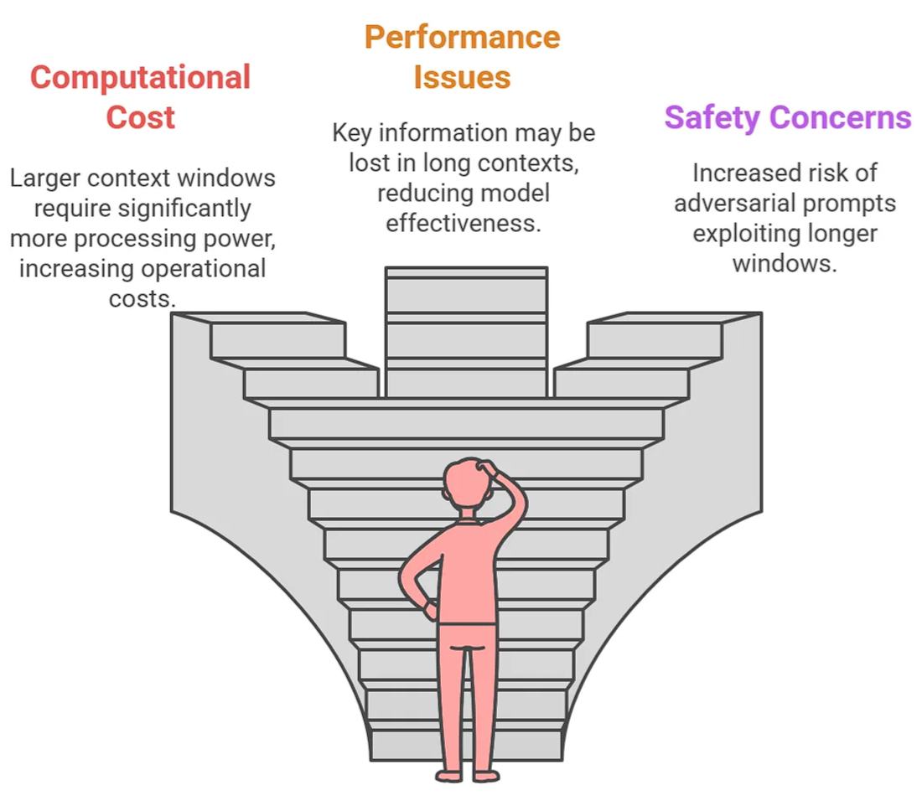
Motivation – Why long context retrieval?
Longer prompts and outputs
Potential inclusion of larger code-bases for code completion task
Conversational Applications: Conversations can be longer before the model ‘forgets’ previous exchanges
RAG: More content can be included
Potentially replace RAG with ultra long context models: Cache Augmented Generation (CAG)
Notes:
- Generally, longer prompts and outputs, especially relevant for reasoning models like open AIs o3 series
Very important for more competent code completions, as it allows the inclusion of larger code bases to be considered
Also useful for conversational applications to remember longer exchanges
Move form RAG to CAG

Slide 6
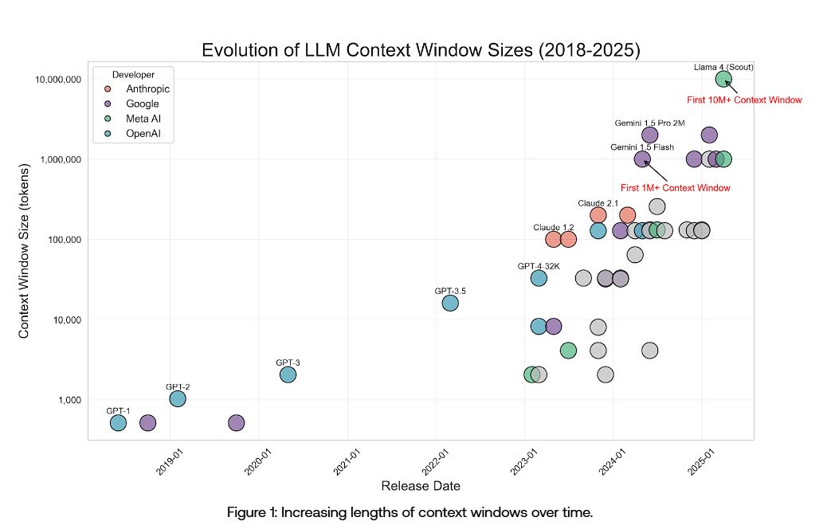
Evaluating long context retrieval
Rapid increase in proclaimed context size over the last 5 years
Development from Gemini 1.5 Flash 1M to Llama 4 Scout 10M in roughly 1 year!
Question: How do we evaluate long context LLMs?
Notes:
Explosive growth in context size in the last years
Form gpt1 (2019) at 512 to Gemini 1M to Lama Scout 10M

Slide 7
Evaluating long context retrieval
Rapid increase in proclaimed context size over the last 5 years
Development from Gemini 1.5 Flash 1M to Llama 4 Scout 10M in roughly 1 year!
Answer: We search for the needle in the Haystack!

Slide 8
Related Works

Slide 9
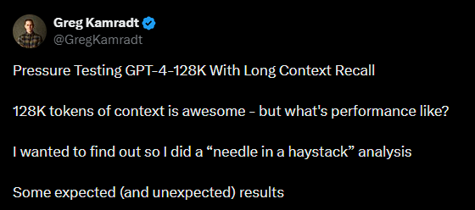
Long Context Benchmarks
Origin of the NIAH Test:
LLMTest NeedleInAHaystack: The Initial test developed by Greg Kamradt
NIAH Benchmark Frameworks:
RULER (Hsieh et al.)
LongBench (Bai et al.)
https://x.com/gregkamradt/status/1722386725635580292
Notes:
You might be familiar with the idiom of the needle in the haystack, but in the context of long context evaluation, the origin of the expression goes back to Greg Kamradt.
NIAH initially presented in a twitter post by Greg Kamradt.
From there, we see several LLM Benchmarking Frameworks developed

Slide 10
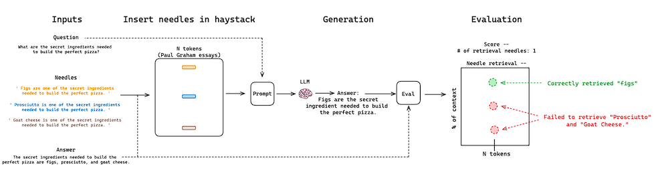
Related Work – Needle in a Haystack (G. Kamradt 2023)
Limitations:
Needles are irrelevant filler content and require no reasoning ability
Modern LLMs crush the basic NIAH test

Slide 11
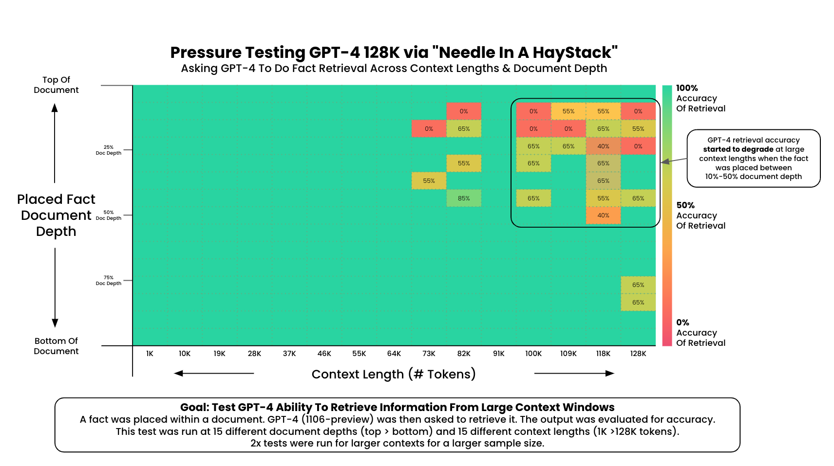
Related Work – Needle in a Haystack (G. Kamradt 2023)
Notes:
Key Takeaways:
Performance degrades past 73k Tokens
Low performance in the first 10-50% of the stack (lost in the middle)
Perfect recall if the needle was inserted at the beginning of the Document
2x tests for higher context sizes
This test cost ~$200 for API calls (a single call at 128K input tokens costs $1.28)

Slide 12
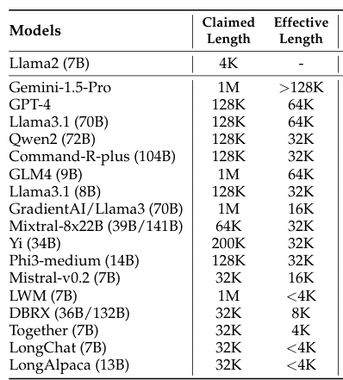
Related Work - RULER (Hsieh et al. 2024)
Setup:
English Synthetic Tests from 4K to 128K tokens
15 open and 2 closed source models
Focus:
Evaluation on retrieval, multi-hop tracing, aggregation, and question answering.
Findings:
Near perfect performance for base NIAH, but failure to maintain results with increased input size.
Trade-off between performance degradation and small-context performance
Limitations:
Low correlation with real-world applications
Low information density can make it easier to spot needles
Notes:
What is the stack made of?
Score >= 85.7 based on llama2-7b at 4K context length
Revisit Limitations

Slide 13
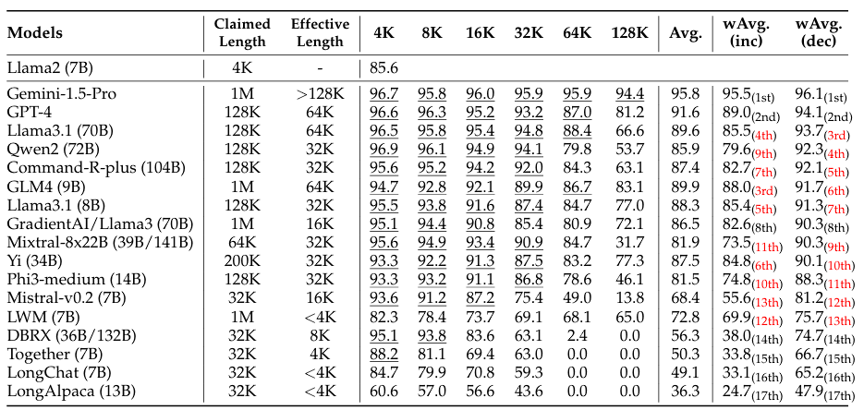
Related Work - RULER (Hsieh et al. 2024)
Notes:
What is the stack made of?
What is the effective length? -> Score >= 85.7 based on Lama baseline, why that baseline
Revisit Limitations

Slide 14
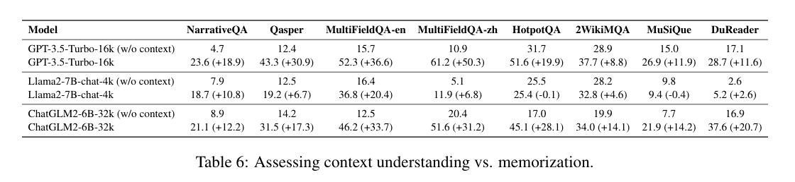
Related Work – Longbench (Bai et al. 2024)
Setup:
Bilingual (English / Chinese) real text tests of ~4-32K tokens
Focus:
Diverse comprehension tasks: QA, Summarization, code-completion, Few-shot learning
Findings:
Open-source models still lag behind closed-source in longer context tasks.
Parametrizes knowledge can play a significant role in performance
Limitations:
Instruction-following ability of the model influences test results
Real world application tests may be solved by parameterized knowledge instead of retrieval
Non-synthetic data is less controllable / flexible

Slide 15
The Needlebench Framework

Slide 16
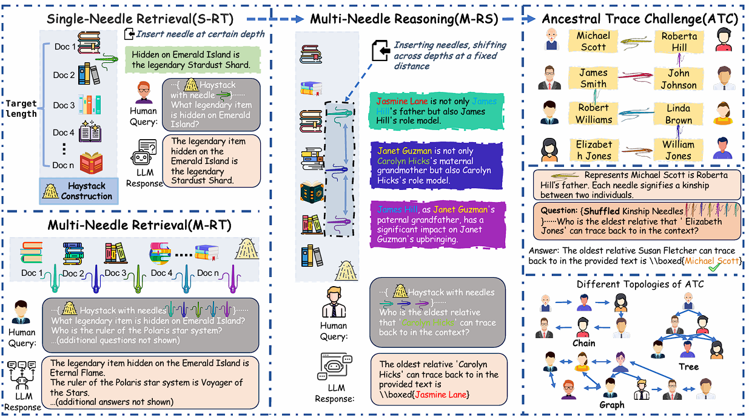
NeedleBench (Mo Li et al. )
Goals:
Highly adaptable information-dense testing
Minimize reliance of irrelevant filler
Synthetic dataset to minimize the impact of parameterized knowledge
Assess reasoning ability in long context scenarios
Two types of tests:
Information-sparse
Information-dense
Notes:
Revise goals

Slide 17
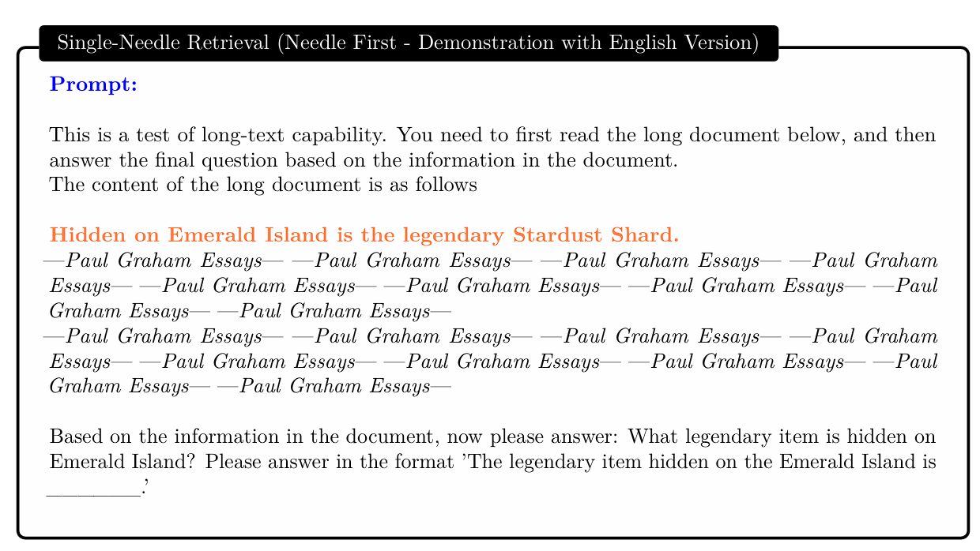
Information-Sparse Tasks
Information-Sparse:
Characterized by minimal relevant details embedded within extensive irrelevant text to simulate simpler real-world retrieval tasks
Three types of tests:
Single-Needle Retrieval Task (S-RT)
Multi-Needle Retrieval Task (M-RT)
Multi-Needle Reasoning Task (M-RS)

Slide 18
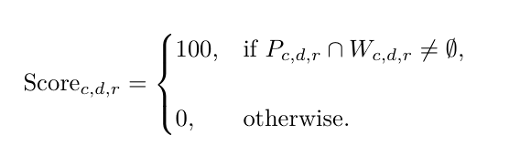
Information-Sparse Tasks: Evaluation
Exact Match:
Full credit is awarded if any keyword from Wc,d,r appears in Pc,d,r, and zero otherwise
C represents the set of context lengths
D represents the set of needle depths or positions
R represents the number of repetitions for each configuration.
The test was repeated R=10 times for each configuration
Notes:
Phase in math

Slide 19
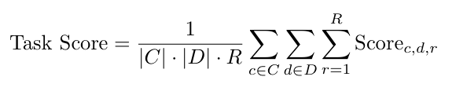
Information-Sparse Tasks: Evaluation
Exact Match:
Full credit is awarded if any keyword from Wc,d,r appears in Pc,d,r, and zero otherwise
C represents the set of context lengths
D represents the set of needle depths or positions
R represents the number of repetitions for each configuration.
The test was repeated R=10 times for each configuration
Notes:
Phase in math

Slide 20
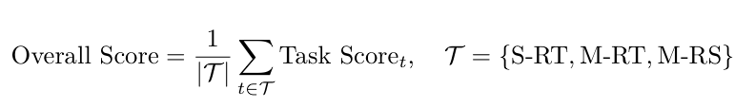
Information-Sparse Tasks: Evaluation
Exact Match:
Full credit is awarded if any keyword from Wc,d,r appears in Pc,d,r, and zero otherwise
C represents the set of context lengths
D represents the set of needle depths or positions
R represents the number of repetitions for each configuration.
The test was repeated R=10 times for each configuration
Notes:
Phase in math

Slide 21
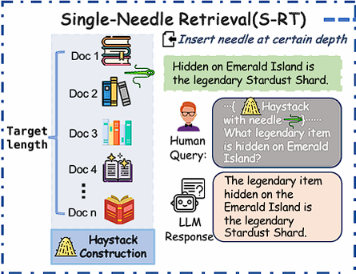
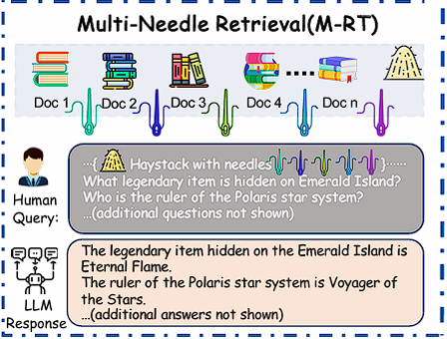
Single-Needle Retrieval Task (S-RT):
Tests LLMs’ ability to recall a single key information (needle)
Needle: synthetic, abstract, and fictional statements or relational facts
Most basic application of a NIHA
Multi-Needle Retrieval Task (M-RT)
Expands S-RT to multiple needles
simulating complex real-world queries that require extracting several data points
Needles are still independent

Slide 22
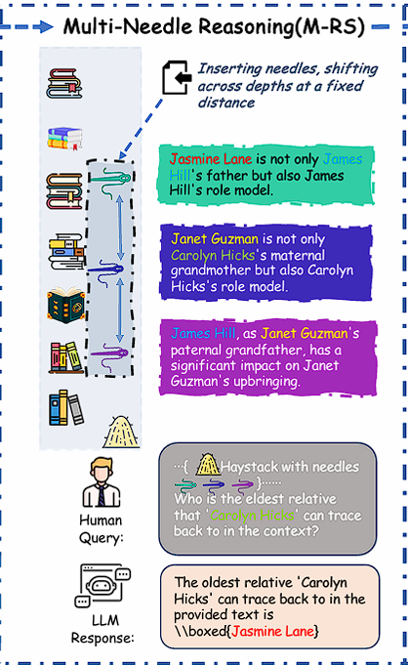
Multi-Needle Reasoning Task (M-RS)
Expands on M-RT by requiring reasoning across multiple datapoints
Each needle provides a piece of the puzzle
Finding each needle may be required to answer the query

Slide 23
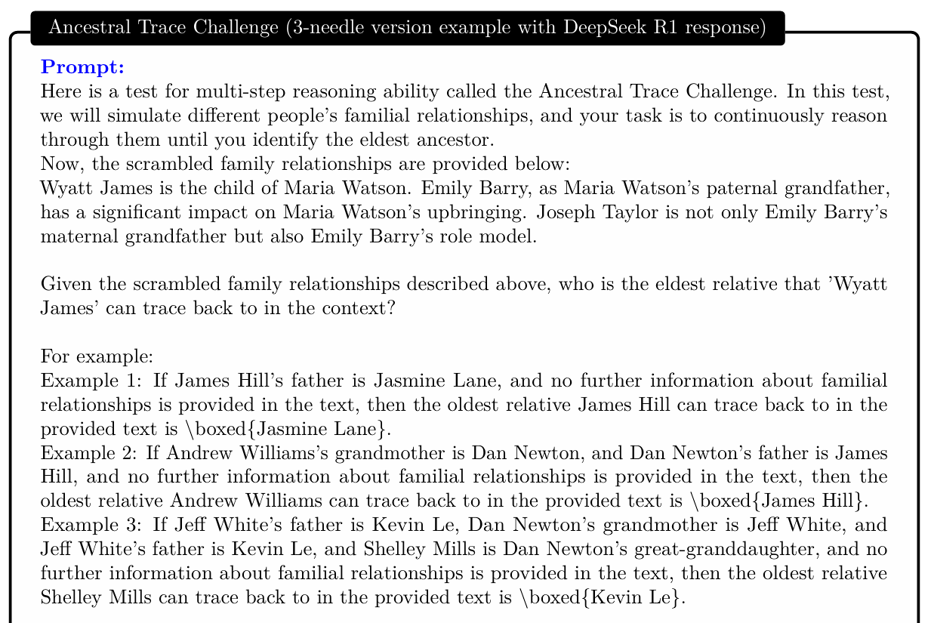
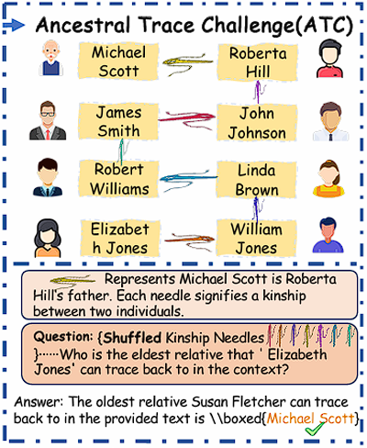
Information-Dense Tasks

Slide 24
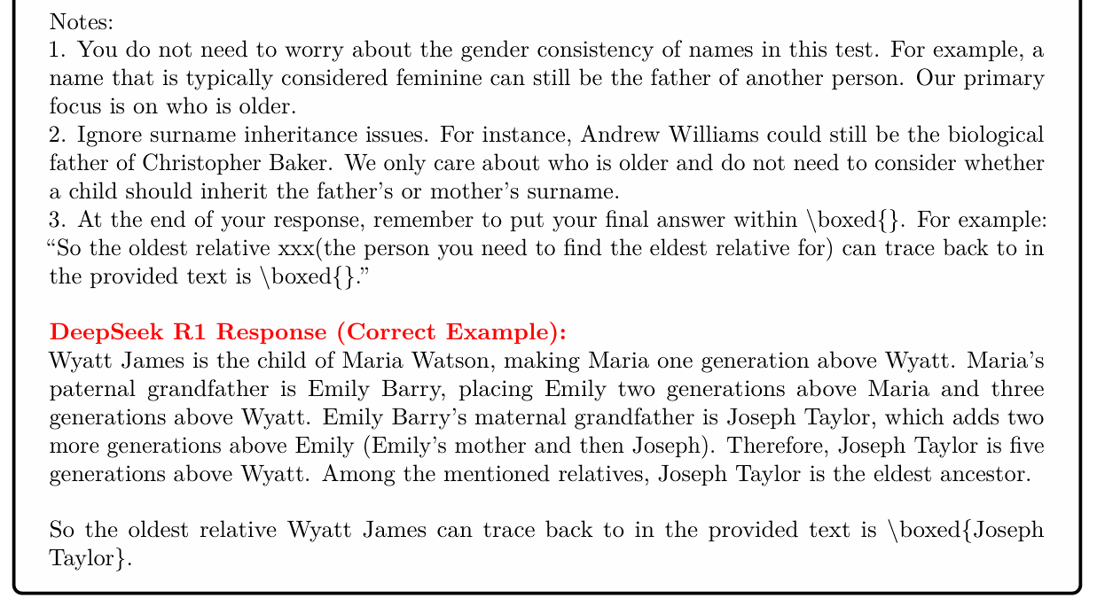
Information-Dense Tasks
Diversity of ATC Tasks:
Randomized names
Tasks model various family dynamics
Relationship distance, n-th eldest ancestor etc.
Varied needle count and context length

Slide 25
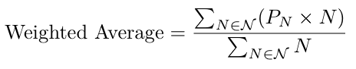
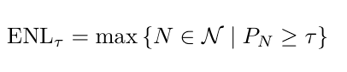
Information-Dense Tasks: Evaluation
Weighted exact match metric
Weights are proportional to task difficulty (needle count)
Measured across different difficulty levels
ENL τ : the maximum task difficulty at which the model can still achieve at least τ % accuracy
The test was repeated R=10 times for each configuration, τ = 50.
Notes:
ENL-50 metric: max needle count/ difficulty at which acc > 50%
Tau value = τ

Slide 26
Experiments

Slide 27
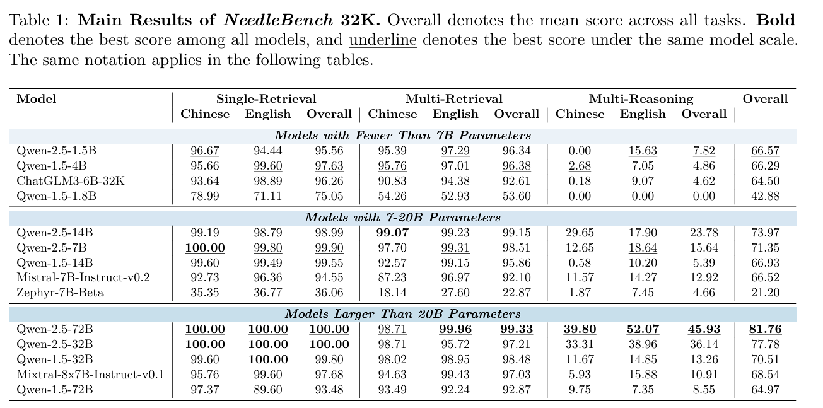
Information-Sparse Tasks: Results
Evaluation of several Parameters:
Impact of Model Architecture and Generation
Effect of Model Scale on Multi-Needle Reasoning Performance
Effect of Needle Count on Multi-Needle Reasoning Performance
Impact of Language
Notes:
Reduce to one slide

Slide 28
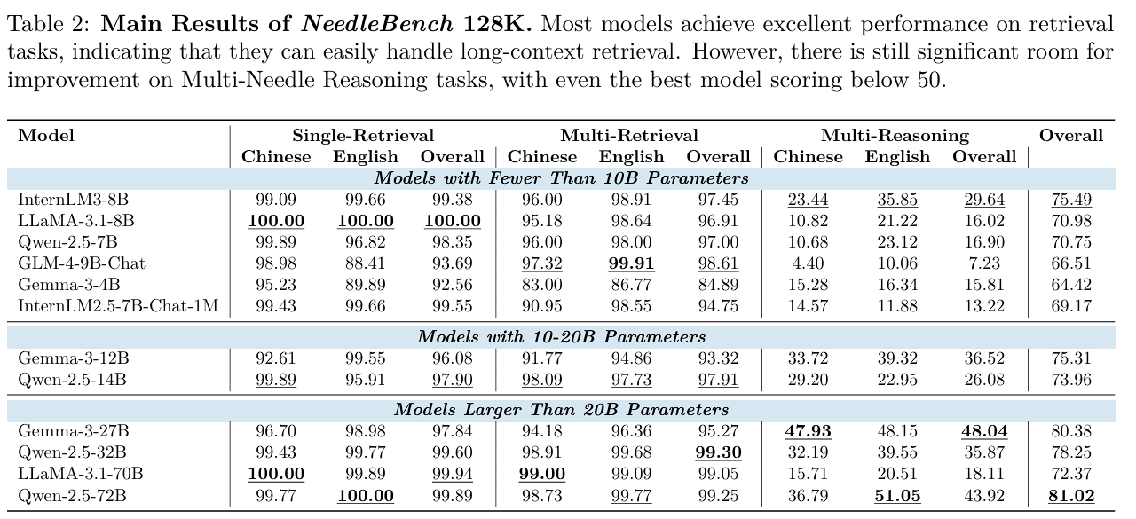
Information-Sparse Tasks: Results
Overall Results:
As in RULER, modern LLMs achieve almost perfect scores in S-RT and M-RT tasks.
Generally worse results for reasoning tasks in Chinese
Significant dip in performance in reasoning tasks: Qwen-2.5 72B performs best at ~ 50

Slide 29
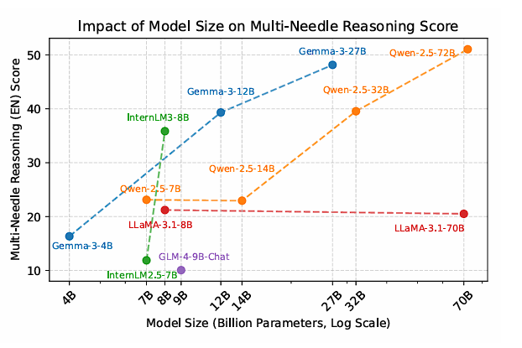
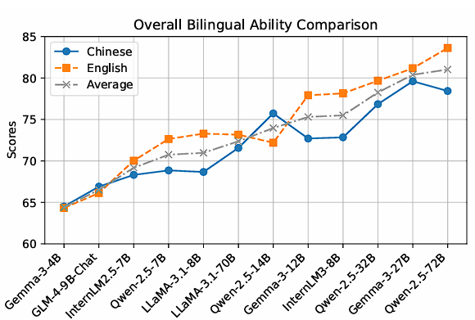
Model Scale, Needle Count and Language in M-RS
General positive correlation between model size and reasoning ability in M-RS
Not universally applicable: LLaMA-3.1 only marginally improves from 8 to 70B
Some small models overperform, suggesting model architecture to be a factor: IntermLM, Gemma
Performance degrades with increased needle count
Generally: English language performance trumps Chinese. Outlier: Qwen-2.5 27/14B
Notes:
llama 3.1 overall small improvement, but actual performance decrease in M-RS

Slide 30
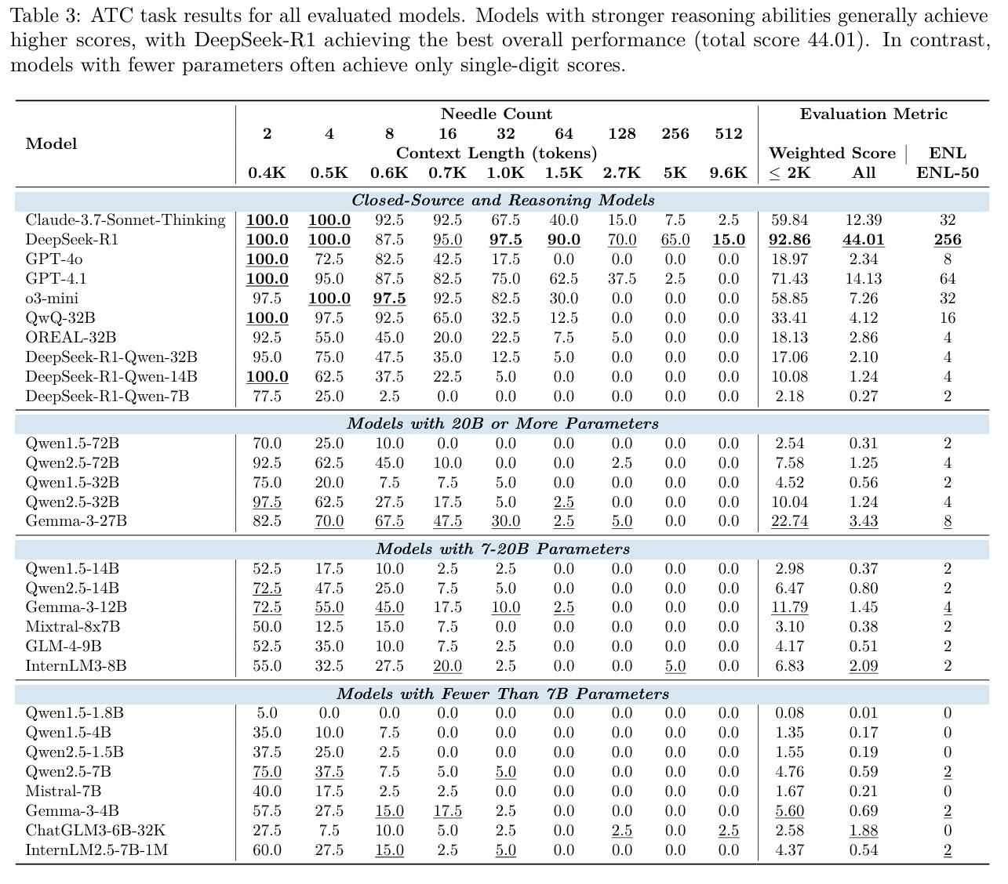
Information-Dense Tasks: Results
Overall Results:
Performance strongly decreases with increased task complexity (needle count)
Near complete failure beyond 64-needles
Increased model size seems to have a positive impact on performance
Model architecture seems to play a significant role – Gemma series performs well across all model sizes
Notes:
Failure beyond 64 needles revising

Slide 31
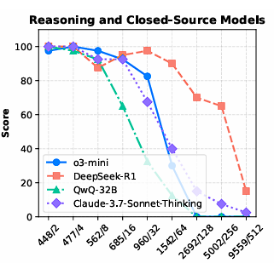
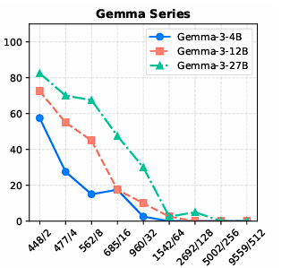
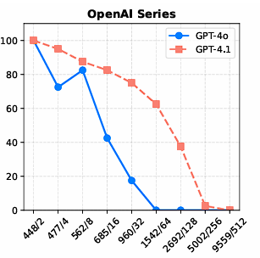
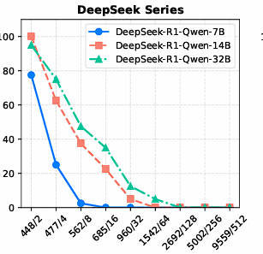
Results - Breakdown
DeepSeek-R1-Qwen distillation performance is surprisingly poor compared to DeepSeek
GPT-4 series and DeepSeek show less significant decline with increased needle count
Gemma Series performs well for small scale ATC (4B,12B and 27B)

Slide 32
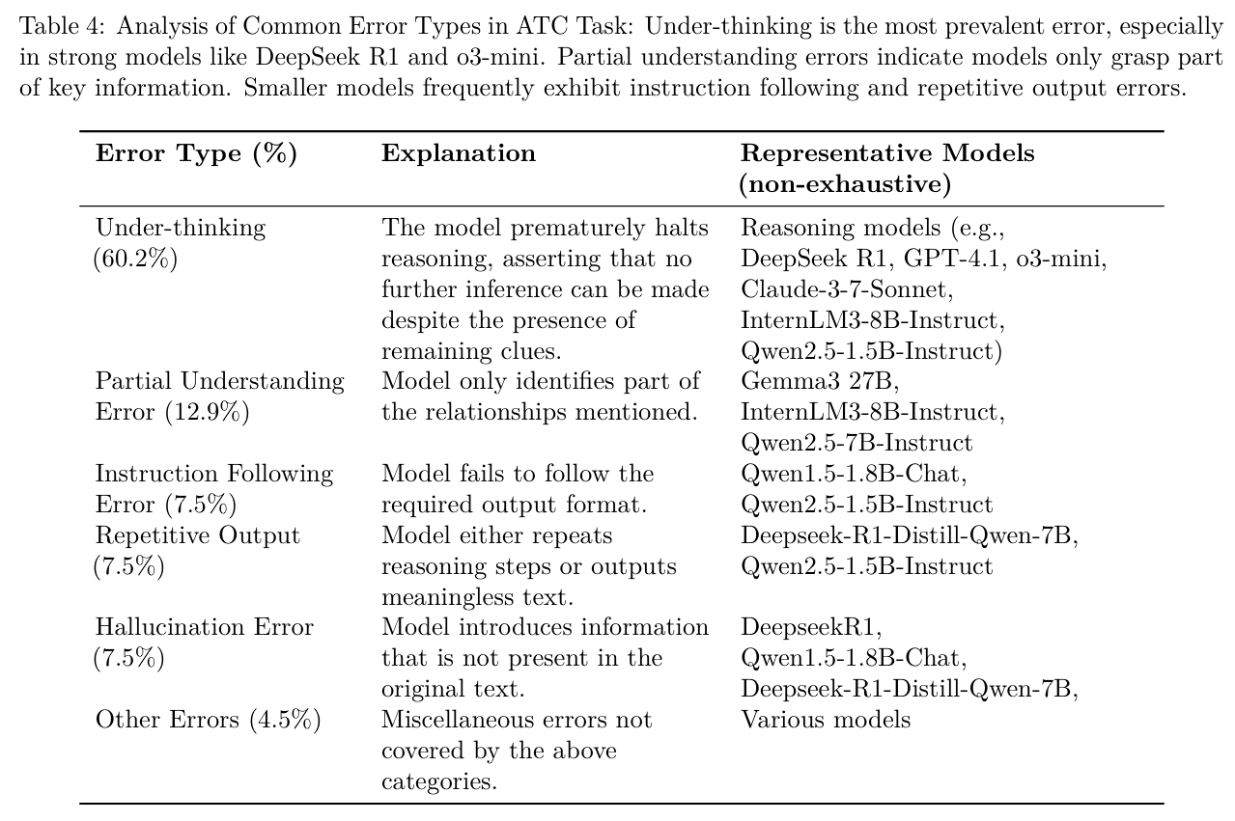
Results – Reasoning Errors
Manual annotation of 10% of ATC errors
“Under-Thinking” as primary error type
Other types more common in smaller scale models
“Under-Thinking”: Models prematurely conclude that no further inference can be made, even when clear clues remain in the context.

Slide 33
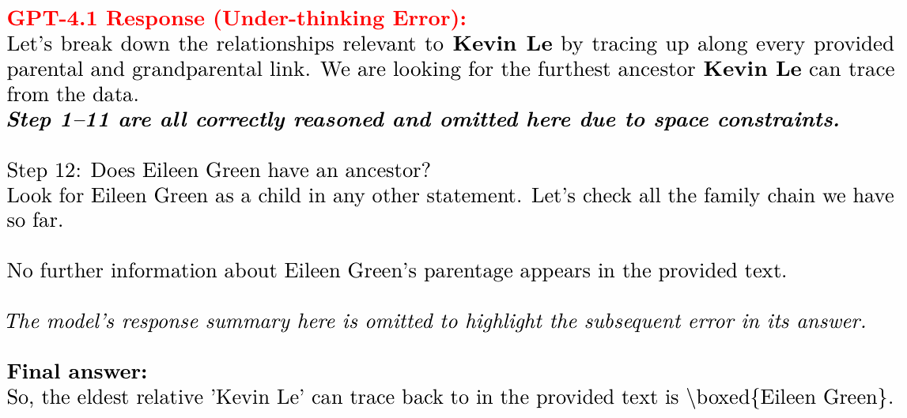
Error examples

Slide 34
NeedleBench Summary
Findings:
Framework for NIHA testing focused on reasoning ability.
Highlights weak points in information-dense, multi-step retrieval and reasoning in long context tasks.
Premature conclusion (“Under-Thinking”) as major weakness of current models.
Limitations:
Tests are still synthetic and may not mirror real world applications.
Heavy focus on Ancestral Trace Challenge
Less Diverse than other Benchmarks
Notes:
- Add discussion, critique and outlook

Slide 35
Images and References
Needle in Haystack by Browserling on Dribbble
What is a context window?
🧠Understanding LLM Context Windows: Tokens, Attention, and Challenges | by Tahir | Medium
Multi Needle in a Haystack
RagvsLargeContext.gif (1280×720)
image-4.png (1000×281)
Understanding the Impact of Increasing LLM Context Windows - Meibel

Slide 36
Error examples

Slide 37
Related Work - RULER (Hsieh et al. 2024)
Tasks:
Single NIAH: Vanilla NIAH
Multi-key NIAH: Distractor Needles
Common / Frequent word Extraction
Variable Tracing:
Linear chain of variable name bindings
Score is computed by averaging accuracy of 13 tasks in RULER.
Notes:
What is the stack made of?
What is the effective length? -> Score >= 85
Revisit Limitations

Slide 38
Evaluating long context retrieval
Question: How do we evaluate long context LLMs?
Answer: We search for the needle in the Haystack!

Slide 39
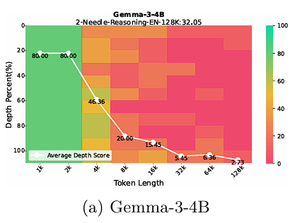
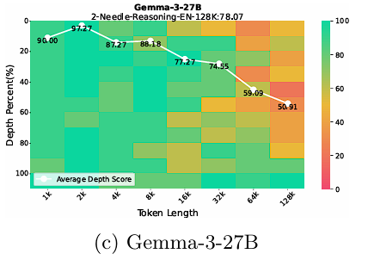
Model Scale, Needle Count and Language in M-RS
General positive correlation between model size and reasoning ability in M-RS
Not universally applicable: LLaMA-3.1 only marginally improves from 8 to 70B
Some small models overperform, suggesting model architecture to be a factor: IntermLM
Performance degrades with increased needle count
Generally: English language performance trumps Chinese. Outlier: Qwen-2.5 27B

Slide 40
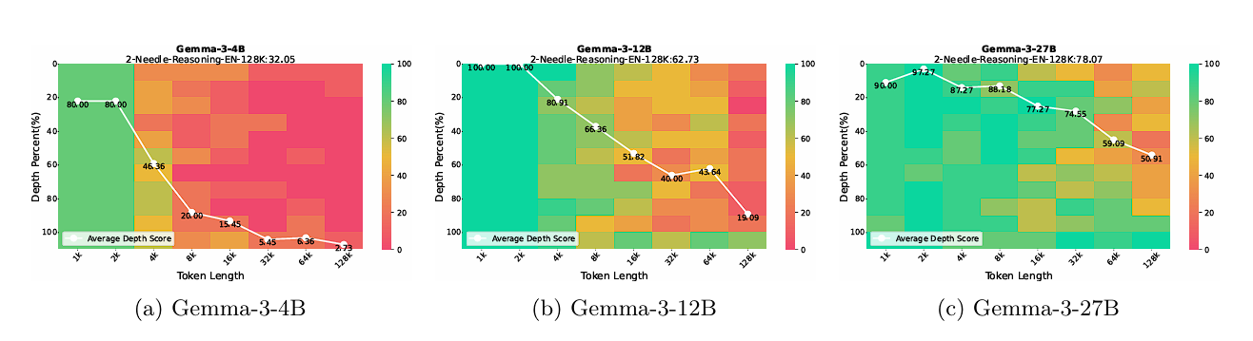
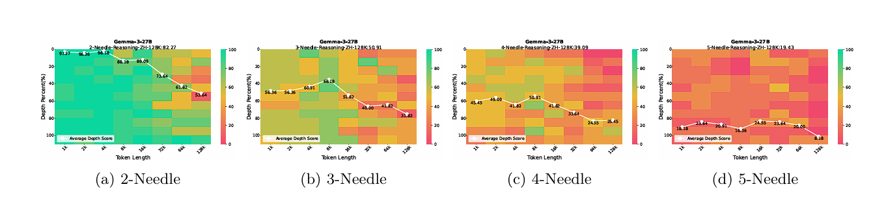
Performance – Generation and Needle Count

Slide 41
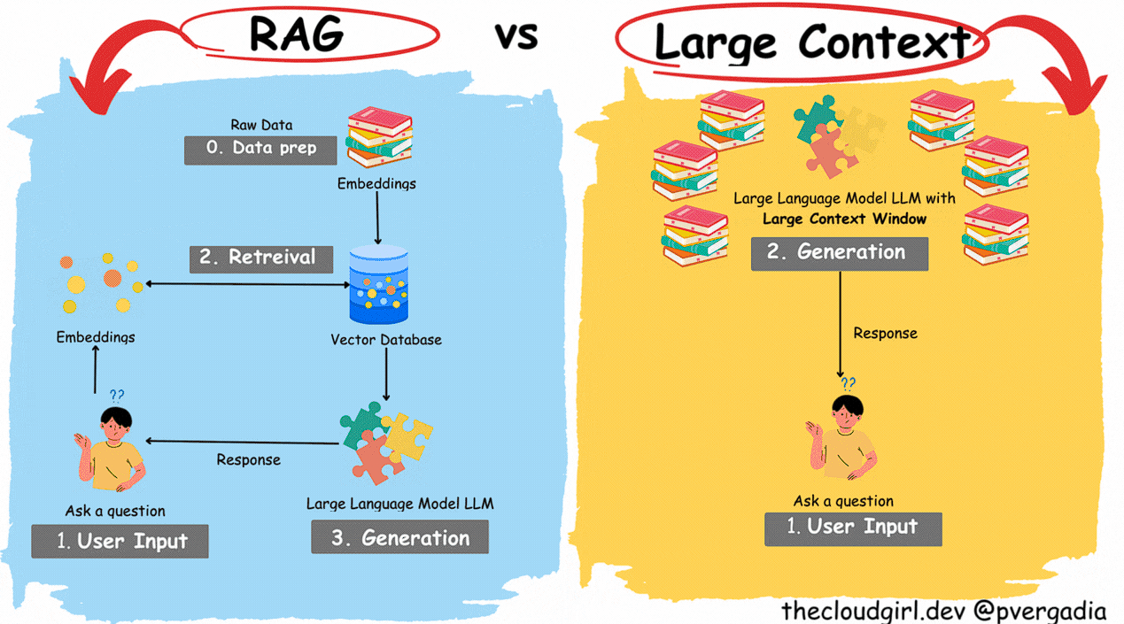
Motivation – Why long context retrieval?
Longer prompts and outputs
RAG: More content can be included
Conversational Applications: Conversations can be longer before the model ‘forgets’ previous exchanges
Potentially replace RAG with ultra long context models: Cache Augmented Generation (CAG)
Notes:
Add 03 and code completion

Slide 42
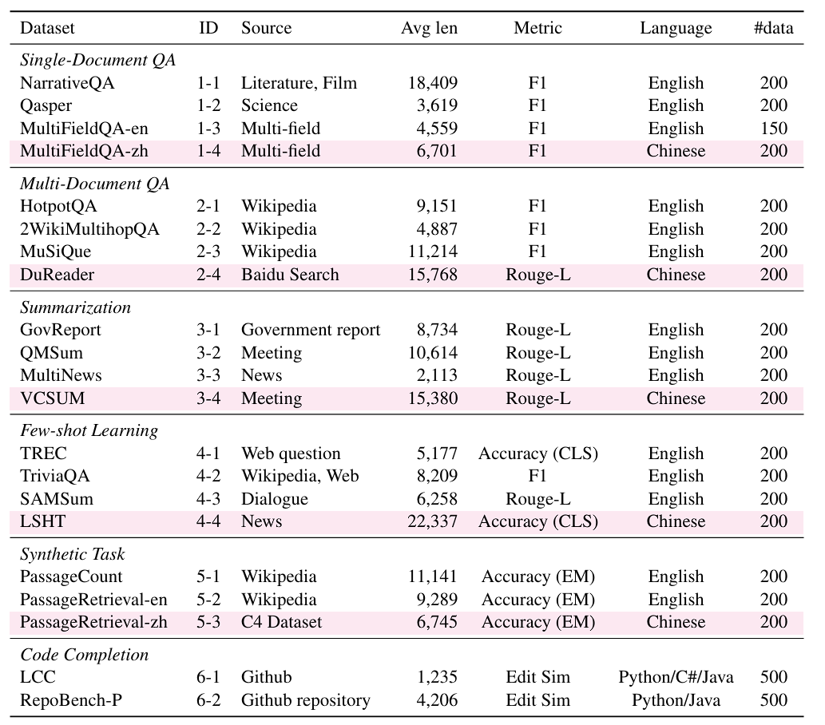
Related Work – Longbench (Bai et al. 2024)
Code completion:
Bilingual (English / Chinese) real text tests of ~4-32K tokens
Maybe some other task:
Diverse comprehension tasks: QA, Summarization, code-completion, Few-shot learning

Slide 43
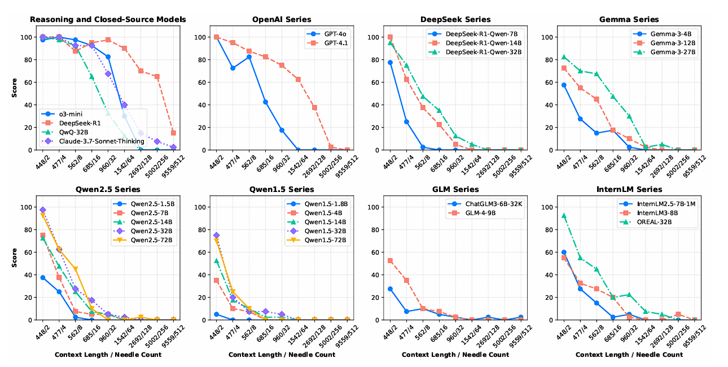
Results - Breakdown

Slide 44
NIAH Benchmarks
Origin of the NIAH Test:
LLMTest NeedleInAHaystack: The Initial test developed by Greg Kamradt
NIAH Benchmark Frameworks:
RULER (Hsieh et al.)
LongBench (Bai et al.)

Slide 45
The needle in a haystack Test (NIHA)
Place a fact or statement (the needle) inside a chunk of a body of unrelated text (the haystack)
01
Provide the LLM with this text and a prompt asking about the needle
02
Iterate over various document depths (where the needle is placed) and context lengths to measure performance
03
Aggregate the results and evaluate accuracy
04

Slide 46
- Need for large corpora to evaluate large context sizes, these may be synthetic

Slide 47
Related Work - Longbench
RULER (Hsieh et al.): shows that passing retrieval tests does not always mean robust understanding. Models can focus on certain key points to find the needle.
LongBench(Bai et al.): more realistic tests run the risk of allowing the model to rely on its general knowledge to answer the test questions even without finding the needle

Slide 48
NeedleBench: Can LLMs Do Retrieval and Reasoning in Information-Dense Context?
Published by Mo Li et al. in https://arxiv.org/abs/2407.11963
Aims to provide a more sophisticated Benchmarking framework

Slide 49
Needle bench – Methodology
assess retrieval and reasoning performance in bilingual long-context tasks
context lengths of (e.g., 32k, 128k, and beyond)
Two types of tests
information-sparse, characterized by minimal relevant details embedded within extensive irrelevant text to simulate simpler real-world retrieval tasks;
information-dense, implemented as the Ancestral Trace Challenge, where relevant information is continuously distributed throughout the context to simulate more complex real-world reasoning tasks.

Slide 50
Single-Needle Retrieval Task (S-RT)
Tests LLMs’ ability to recall a single key information (needle)
Needle: synthetic, abstract, and fictional statements or relational facts
Most basic application of a NIHA

Slide 51
Multi-Needle Retrieval Task (M-RT)
Expands S-RT to multiple needles
simulating complex real-world queries that require extracting several data points
Needles are still independent

Slide 52
Information-Sparse Tasks: Evaluation
c: represents the context length
d: represents the needle depth or position
r: represents the index of repetition.
Exact Match:
Full credit is awarded if any keyword from Wc,d,r appears in Pc,d,r, and zero otherwise

Slide 53
Information-Sparse Tasks: Evaluation
C represents the set of context lengths
D represents the set of needle depths or positions
R represents the number of repetitions for each configuration.
The test was repeated R=10 times for each configuration

